Slide 1
Mindfulness and Acceptance for Gender & Sexual Minorities: Strategies to Foster Self-Compassion, Connection, and Equality
Matthew D. Skinta, PhD, ABPP, Palo Alto University
Aisling Curtin, MSc, ACT Now Ireland, WTF Psychology
Lisa Diamond, PhD, The University of Utah
14-15 June 2016

Slide 2
Checking in with Where We Are

Slide 4
Aspiration for this Training
Deepening an understanding of our own histories of gender and sexuality
Relating our own heartfelt experience to the transformative work we do
For the sake of deepening our ability to share, we invite everyone to treat what is shared with confidentiality, including anything that the facilitators might share in the service of modelling
Show you what ACT & FAP look like when working with gender and sexuality in 1:1 Real Plays & Role Plays
Give a number of options so that you decide what we cover to best meet your needs, and those of your clients
Give you tools and an ACT/FAP way of being to integrate into your client work in this area if you choose
This workshop will model the ACT/FAP therapeutic relationship- our interactions will shape one another so that we can move towards what matters most here and now- Feedback will be taken and integrated after each segment

Slide 5
Two Kinds of Skills that Increase Your Potency as an Agent of Change
Difficult to learn and to do
Contact
Increasing contact with and decreasing avoidance of your experience of emotions, self, and spirit
“Intellectual” Knowing
Knowing the rules or guidelines of therapy and how to apply them
Relatively easy to learn and do

Slide 6
3 zones
Where the magic happens
Self-care zone
Comfort zone

Slide 7
Bring to mind one GSM client you work with
Write a brief history
Write down what therapeutic interventions you have applied so far and assess these in terms of workability- have they helped or not?
Write down your case conceptualization- why is your client experiencing what they are experiencing in this moment? And what will help them in your work together?

Slide 8
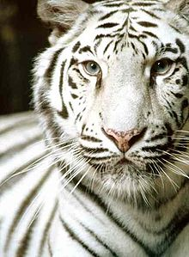
Mohini (Tara Brach)
Mohini was a regal white tiger who lived for many years at the Washington DC National Zoo. For most of those years her home was in the old lion house—a typical twelve-by-twelve-foot cage with iron bars and a cement floor. Mohini spent her days pacing restlessly back and forth in her cramped quarters. Eventually, biologists and staff worked together to create a natural habitat for her. Covering several acres, it had hills, trees, a pond and a variety of vegetation. With excitement and anticipation they released Mohini into her new and expansive environment. But it was too late. The tiger immediately sought refuge in a corner of the compound, where she lived for the remainder of her life. Mohini paced and paced in that corner until an area twelve-by-twelve feet was worn bare of grass.
Perhaps the biggest tragedy in our lives is that freedom is possible, yet we can pass our years trapped in the same old patterns. Entangled in the trance of unworthiness, we grow accustomed to caging ourselves in with self-judgment and anxiety, with restlessness and dissatisfaction. Like Mohini, we grow incapable of accessing the freedom and peace that are our birthright. We may want to love other people without holding back, to feel authentic, to breathe in the beauty around us, to dance and sing. Yet each day we listen to inner voices that keep our life small. Even if we were to win millions of dollars in the lottery or marry the perfect person, as long as we feel not good enough we won’t be able to enjoy the possibilities before us. Unlike Mohini, however, we can learn to recognize when we are keeping ourselves trapped by our own beliefs and fears. We can see how we are wasting our precious lives.

Slide 9
Mohini
When have you felt closeted/stuck (in a 12 X 12)? (Important- you do not need to identify as GSM in order to feel constrained by societies expectations of gender and sexuality- make this unique to you)
Name one thing you have done to keep yourself in that 12 X 12/Closet
Acknowledge your toward and away moves within this workshop
Write down your four answers anonymously & give to one of the facilitators if willing
Take 3-5 minutes to read what people have wrote in silence
What did you notice?

Slide 10
Setting an Intention
What is your personal intention?
Is there a deeper or more connected reason for choosing this training over the other options?

Slide 11
Loneliness/lack of social connection equivalent to smoking 15 cigarettes a day
=
Holt-Lunstad J, Smith TB, Layton JB (2010) Social Relationships and Mortality Risk: A Meta-analytic Review. PLoS Med 7(7): e1000316. doi:10.1371/journal.pmed.1000316
Notes:
The way to read this chart: “Living with air pollution increases your odds of an early death by 5%. Obesity increases your odds of an early death by 20%....
http://www.plosmedicine.org/article/info%3Adoi%2F10.1371%2Fjournal.pmed.1000316#s4

Slide 12
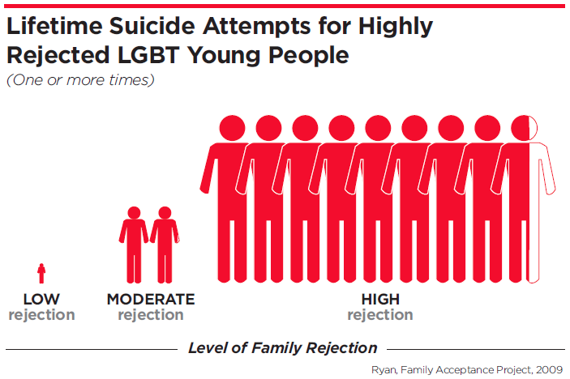
Rejection and isolation profoundly affect GSM lives
Among gay men, the lifetime occurrence of depression is nearly 4 times that of heterosexual men; among lesbians, double that of heterosexual women (IOM, 2011)
50% of transgender individuals have experienced sexual assault. Transwomen have a 1 in 12 chance of being murdered, and 1 in 8 for transwomen of color. 41% have attempted suicide (TSER, 2015)
Despite a greater utilization of mental health services, most psychologists report little or no training in working with sexual minorities
Notes:
By dividing the world into normal and healthy versus abnormal and disturbed – we have failed to see that most humans are hurting.
Normal to abnormal.
Why? The answer must lie in the ordinary.

Slide 13
Kicked Out: LGBT Youth
https://www.youtube.com/watch?v=TUhqodigPFk

Slide 14
Lisa Diamond Block

Slide 15
Afternoon Block 1
Matthew

Slide 16
Minority Stress and Stigma
Minority stress theory suggests a broad range of mechanisms for the impact of societal stigma
Self-stigma (e.g., internalized homophobia; Yadavaia & Hayes, 2012)
Stigma/Expectation of Rejection
Outness/Concealment
Discrimination
Community connectedness
Related to a broad range of psychological symptoms
May be due to reduced emotion regulation

Slide 17
Notes:
Inspired by Hatzenbuehler’s model

Slide 18
Targeting Emotion Dysregulation
Mindfulness and acceptance based approaches promote emotion regulation skills, with specific evidence in mechanism-of-action studies supporting:
Dialectic Behavioral Therapy
Mindfulness-Based Cognitive Therapy
Acceptance & Commitment Therapy
Barlow’s Unified Protocol (e.g., Prochaska et al, 2016)

Slide 19
Acceptance and Mindfulness Processes
Notes:
Mostly about antecedent control- examine and attempt to manipulate what happens before avoidant and other problem behaviors in order to predict and influence it- will come back to this

Slide 20
Commitment and Behavior Change Processes
Notes:
Mostly about consequential control- after behavior- will come back to this but first have to talk about initial steps (the first few sessions)

Slide 21
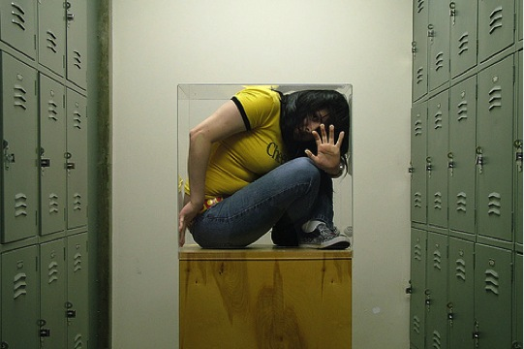
What does the GSM Hexaflex look like?
Discrimination - Preoccupied with past/future mistreatment
Expectation of Rejection - Unwillingness to experience fears of being seen as GSM
Concealment – Overachievement or avoidance of attention
Self-stigma - Fusion with thoughts about GSM stereotypes
Unclear or unexamined desires for authentic and full living
Rigid Perspective taking - small picture
(ACBS, 2015)

Slide 22
How GSM Individuals become Psychologically Flexible…
Connection to present moment
Emotions- Willingness to experience any fears & cultivating compassion
Clear on what is important, including relationships and community
Thoughts- Unhooked from Unwanted Thoughts about GSM Identity
Doing things that matter as a whole, present GSM person
Flexible Perspective Taking – Part of a Larger Community
(ACBS, 2015)

Slide 23
Exploring our own Histories

Slide 24
Lyrics: Leviticus: Faggot
Faggot better run learn to run 'cuz daddy's home
His sweet lil' boy just a little too sweet
Every night the man showed the faggot what a real man should be
The man and the faggot will never see
For so many can't even perceive a real man Tell me
Not that the faggot didn't find a woman fine and beautiful
He admired desired their desires
He wanted love from strong hands
The faggot wanted the love of a man
His mother would pray
Save him, save him, save him from this life
Go to church boy
Faggot you're just a prisoner of your own perverted world
No picket fence acting like a bitch that's all he sees ain't that what faggot means
No love dreams
Only the favors sweet Michael performed for money to eat
'Cause the man kicked the faggot out the house at 16
Amen mother let it be
Before long he was crowned QUEEN for all the world to see bloody body face down
The wages of sin are surely death that's what mama used to say
So there was no sympathy
Let he without sin walk amongst the hated and feared and know true trial and tribulations
See my dear we're all dying for something searchin' and searchin'
Soon mama found out that god would turn his back on her too
Save me save me from this life
I pray to my Lord above save me they say you're the way the light

Slide 25
Video
https://www.youtube.com/watch?v=U0N83NvSfk4

Slide 26
Sexuality & Gender Life History
Speak for 6 minutes about ways that you have been taught to express your gender or your sexuality professionally and personally – regardless of your identity
Consider your personal “12x12”, and what would be a forward move in disclosure
Listener – focus primarily on listening non-verbally
If you notice it, you might consider a gentle or minimal encouragement to share more deeply
Authentically and openly share the impact that hearing your partner’s story has had on you (4 minutes)

Slide 27
GSM Hexaflex Processes in the Life History
Acceptance – of unwanted emotional experiences, including shame
Defusion – from fears that others might reject us for our stories
Present-Moment Awareness – attending to what it is like to connect with this content, here and now
SAC/Perspective-Taking – having the chance to experience our stories through the eyes of another, shifting the context
Values –the willingness to take this conversation as deeply as you are ready
Committed Action – consider the intention set at the beginning of the day

Slide 28
Afternoon Block 2
Aisling
Functional Analytic Psychotherapy
Integrating ACT & FAP with issues regarding gender and sexuality
Real Plays & Experiential Focus

Slide 29
Clinically Relevant Behaviors (CRBs) are the operants that are the HEART of FAP
CRB1s------------CRB2s
“problem”
behaviors
in session
improved
behaviors
in session

Slide 30
CLINICALLY RELEVANT BEHAVIORS (CRBs)
CRBs are related to clients’ goals for treatment. They occur in session and can be addressed right on the spot.
CRB1s: Client in-session (in-vivo) PROBLEMS
CRB2s: Client in-session (in-vivo) IMPROVEMENTS
Identify these to maximize therapeutic change
CRB3s: Client interpretations of behavior
CRB’s occur in session and can be addressed on the spot

Slide 31
THE FIVE RULES
CLINICALLY RELEVANT BEHAVIORS (CRBs)
Watch for CRBs. [Awareness]
Evoke CRBs. [Courage]
Reinforce CRB2s. [Love]
Notice effects of your behavior. [more Awareness inc T1s & T2s]
Provide functional interpretations of behavior and implement generalization strategies. [interpret and generalize]
ACL
CRB1s & CRB2s
Notes:
Point out that awareness scourge in love functionally defined, what is courageous and loving for one person might be a step forward for another it might be less than they could have done in print e.g. a 1

Slide 32
Reinforcing Strategies: Where are you speaking from?
Mary Loudon, 2015
ALL OF US
Arbitrary R+
“Good job!”
Natural R+
Personal and true, but intellectual. Just words.
Natural R+
From your core, authentic,
vulnerable, unique to you, and tailored for your client.
Notes:
Your emotional vulnerability can penetrate much deeper than words alone.

Slide 34
3 zones
Where the magic happens
Self-care zone
Comfort zone

Slide 35
Adapted Intimacy Generating Questions
If you could change anything about the way you were raised in terms of messages about sexuality or gender, what would it be?
Share an embarrassing or shameful moment relating to gender or sexual expression in your life.
What is a painful memory for you in terms of sexuality or gender? Have you come to terms with what happened? If yes, how? If no, is there anything you would like to do to resolve what happened so that it eases your pain around this?
Tell me about a fear in relation to sexuality or gender that holds you back and stops you from being the person you would like to be. What would it look like if you were no longer hooked by that fear and could do what is important to you even when the fear is there?
What rules did you learn throughout childhood, adolescence and adulthood about sexuality and gender?

Slide 36
Real-Play

Slide 38
Your Turn: Adapted Intimacy Generating Questions (Aron et al., 1997)
If you could change anything about the way you were raised in terms of messages about sexuality, what would it be?
Share an embarrassing or shameful moment relating to gender/sexual expression in your life.
What is a painful memory for you in terms of sexuality? Have you come to terms with what happened? If yes, how? If no, is there anything you would like to do to resolve what happened so that it eases your pain around this?
Tell me about a fear in relation to sexuality that holds you back and stops you from being the person you would like to be. What would it look like if you were no longer hooked by that fear and could do what is important to you even when the fear is there?
What rules did you learn throughout childhood, adolescence and adulthood about sexuality?

Slide 39
What do you need now?
Sexuality Spectrum
No Mud, No Lotus
Common Humanity
Inside V’s Outside Control
Anything else?

Slide 40
Day 2 Block 1
Aisling
Role Plays and Experiential
Link Practice to Theory & Theory to Practice

Slide 41
Let’s connect to a GSM Client that You’ve Struggled With

Slide 42
Role Play: GSM Client You’ve Struggled with
Connection to present moment
Emotions- Willingness to experience any fears & cultivating compassion
Clear on what is important, including relationships and community
Thoughts- Unhooked from Unwanted Thoughts about GSM Identity
Doing things that matter as a whole, present GSM person
Flexible Perspective Taking – Part of a Larger Community
(ACBS, 2015)

Slide 43
Your Turn: Connect to a GSM Client that You’ve Struggled With

Slide 44
What do you need now?
Sexuality Spectrum
No Mud, No Lotus
Common Humanity
Inside V’s Outside Control
Anything else?

Slide 45
Day 2 Block 2
Matthew
Gender

Slide 46
Who are y0u?
Gender Identity
Do you feel you are a man,
woman, neither, both?
Gender Expression
How do you present yourself?
Male, female, androgynous?
Biological sex
Refers to genitalia.
Sex assignment at birth.
Sexual Orientation
Who are you attracted to?
Males, females, both?

Slide 48
LGBTQQIAP…
Transgender / Transsexual: Someone who identifies as the opposite gender they were born as.
Cisgender: Person whose gender identity, gender expression, and biological sex all align.
Intersex: Outdated term → Hermaphrodite: A person with a set of sexual anatomy that doesn’t fit within the labels of female or male. Another term: Dualsex
Drag Queen / King: Someone who presents as opposite gender /sex in an exaggerated way, usually in shows, performances.
Cross-dressing: wearing clothing that conflicts with the traditional gender expression of your sex and gender identity
Example: a man wearing a dress.
Reasons: relaxation, fun, and sexual gratification

Slide 49
Gendermap
http://dmarling.deviantart.com/

Slide 50
http://thegenderbook.tumblr.com

Slide 51
Pronoun Etiquette
Pronouns can be a big part of coming into one’s identity
Not limited to she/he
“Ze” and “they”
Incorrect Pronoun Usage
Invalidating
Denying the individual's reality
“I know you better than you know yourself”
Conveying that you are not an ally

Slide 52
Day 2 Block 3
Lisa Diamond

Slide 53
Day 2 Block 4
Mattling

Slide 54
Let’s look at our lives in terms of workability
What are your away moves in your personal & professional life? Perhaps where it could be threatening to be identified as GSM or an ally?
What are your towards moves in your personal & professional life, where you are creating or encouraging GSM acceptance?
What are you trying to run away from in your personal & professional life regarding gender and sexuality?
What allows us to create GSM nurturing spaces?

Slide 55
Let’s look at our lives in terms of workability

Slide 56
Tonglen
Rehearsal for being in the presence of pain/suffering that cannot be mitigated
Practicing resilience for moments of leadership

Slide 57
Come back to your GSM client from yesterday
Has anything shifted?
How will you approach this client differently after this workshop?
Commit to changing one/two small things regularly with your GSM client based on what you’ve learned over the past two days

Slide 58
Headline of the San Francisco Chronicle
Female humpback whale who had become entangled in a spiderweb of crab traps and line weighted down by hundreds of pounds of traps that caused her to struggle to stay afloat.
She also had hundreds of yards of line rope wrapped around her body, tail, Torso, and a line tugging in her mouth. A fisherman spotted her just east of the Farallon Islands and radioed an environmental group for help.
Within a few hours, the rescue team arrived and determined that she was so bad off, the only way to save her was to dive in and untangle her. They worked for hours and eventually freed her.

Slide 59
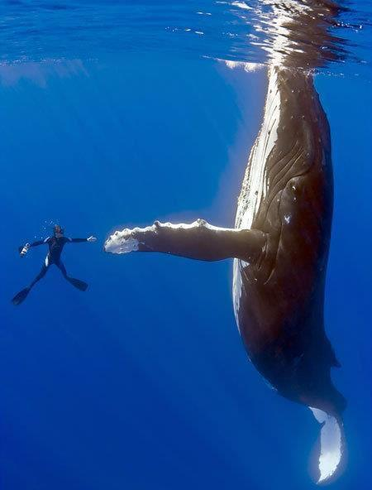
When she was free, the divers say
she swam in what seemed like
joyous circles. She then came back
to each and every diver, one at a time,
and nudged them, pushed them
gently around as she was thanking them. Some said it was the most
incredibly beautiful experience
of their lives. The guy who cut the rope out of her mouth said her eyes were following him the whole time, and he will never be the same.
Notes:
Recent headline of the San Francisco Chronicle.
Female humpback whale who had become entangled
in a spiderweb of crab traps and line weighted down
by hundreds of pounds of traps that caused her
to struggle to stay afloat. She also had hundreds
of yards of line rope wrapped around her body, tail,
Torso, and a line tugging in her mouth. A fisherman spotted her just east of the Farallon Islands
and radioed an environmental group for help.
Within a few hours, the rescue team arrived
and determined that she was so bad off,
the only way to save her was to dive in
and untangle her. They worked for hours
and eventually freed her.

Slide 60
May you, and all those you love, be so blessed and fortunate to be surrounded by people who will help you get untangled from the words and stories that are binding you.
And, may you always know
the joy of giving and receiving gratitude.
Matthew email
aisling@actnowireland.com

Slide 61
Questions? Comments?

